Slide 1

Predicting Customer Buying Behavior
21/06/2025
Joyashree Mandal

Slide 2
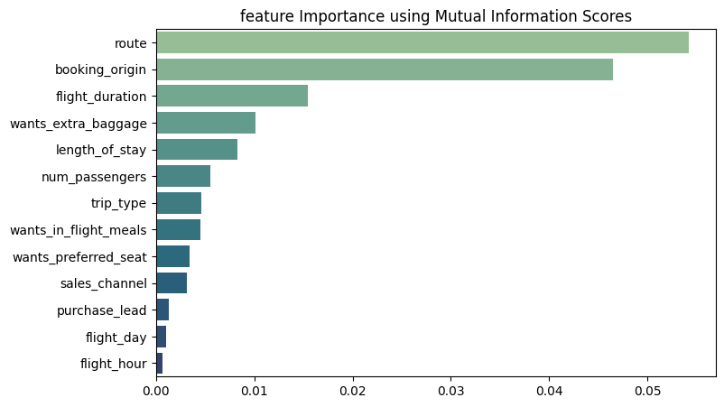
Predictive model to understand factors that influence buying behavior
We have trained the data set with Random Forest Classifier model and received
Training Accuracy: 99.98%
Validation Accuracy: 85.08%
Top 5 features which influence
Customer buying behavior:
route
booking_origin
flight_duration
wants_extra_baggage
Length_of_stay

